Slide 1
Filter
Filter

Slide 2
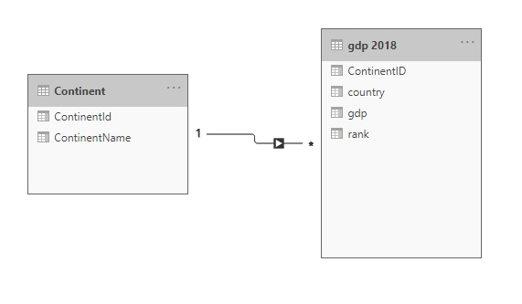
Filter
Note: This Lab uses the gdp.xslx file located in the resources\Drillthrough and Filter folder
Navigate to the location of the gdp.xslx file and load both tables continent and gdp 2018 at the query editor level
Check that the relationship between contains and gdp 2018 is established

Slide 3

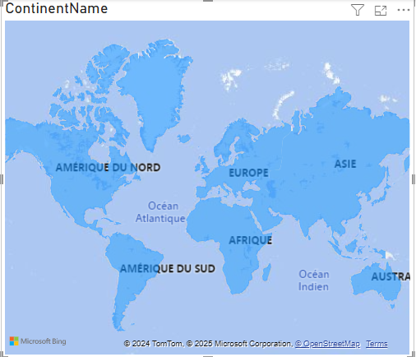
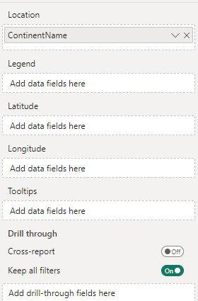
Filter
Name the two pages of the report GDP and Continent Details respectively.
Add Filled Map Visual ContinentName field to the Location property of the map

Slide 4
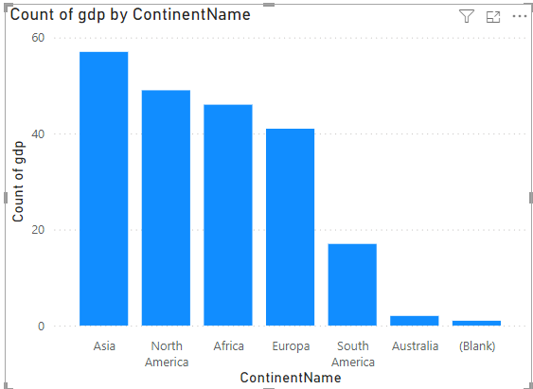
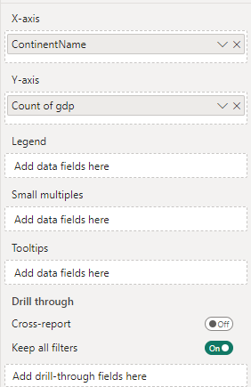
Filter
Add a Table visual to the Details page level and drag the ContinentName , country , Rank and gdp fields to the Values property level

Slide 5
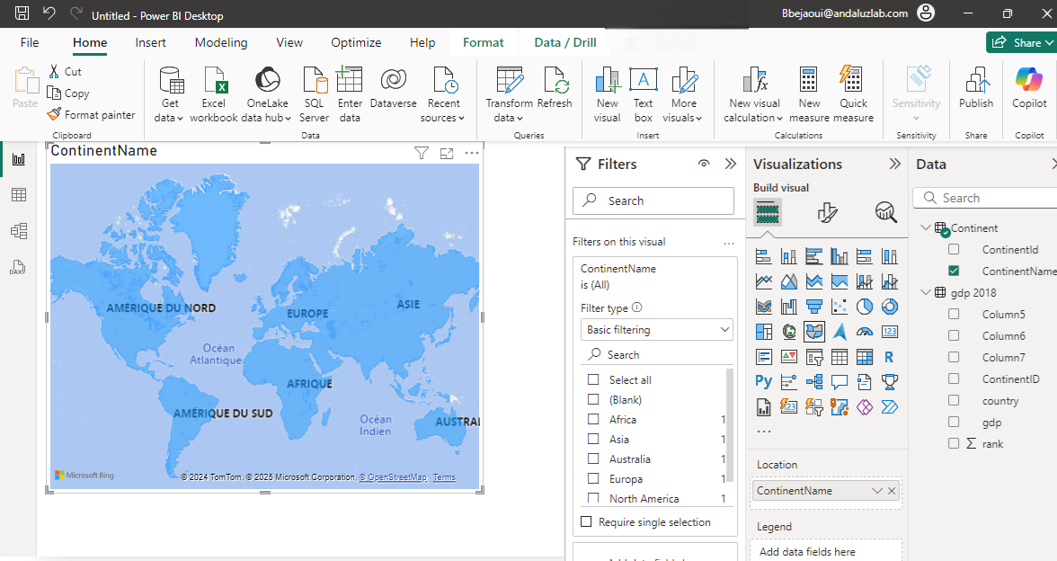
Filter
Name the two pages of the report GDP and Continent Details respectively.
Add Filled Map Visual then drag ContinentName field to the Location property of the map

Slide 6
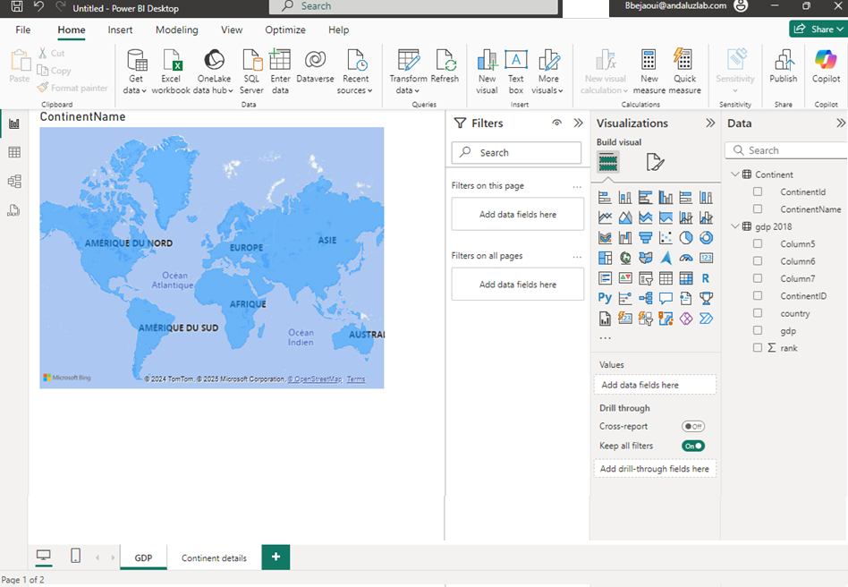
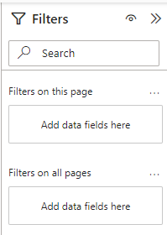
Filter
Note that when no visual is selected the filter pane shows two filter levels
The current page level
All page level
1
2

Slide 7
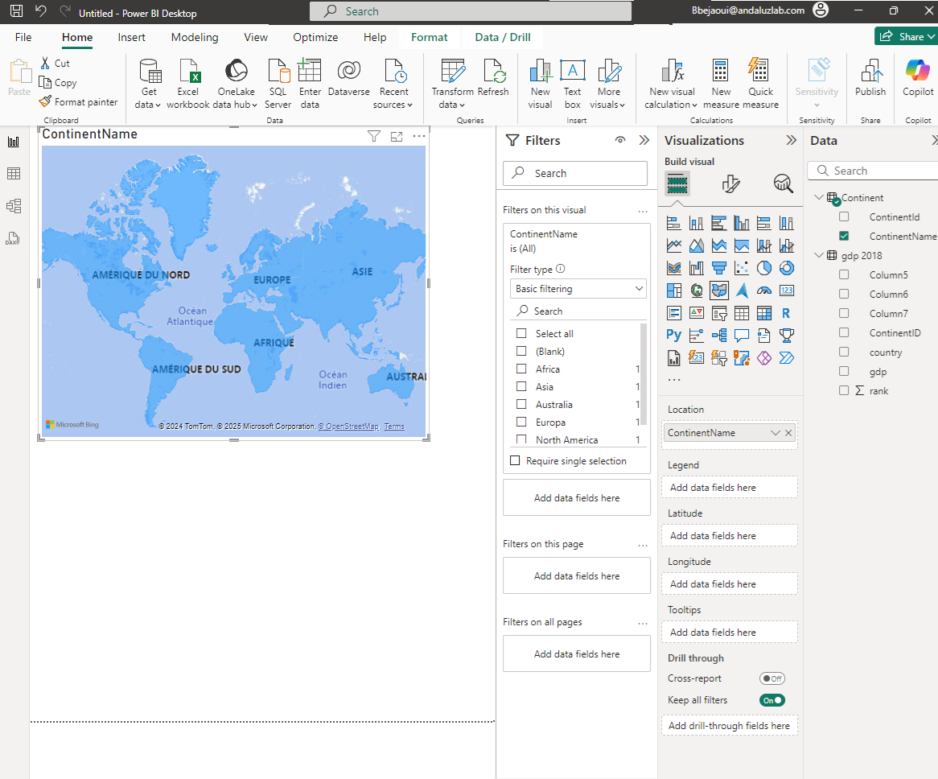
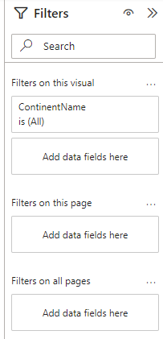
Filter
Note when a visual is selected the Filters pane shows a third filter level, that of the visual
1
2
3

Slide 8
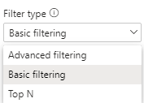
Filter
Try to apply the filter based on the ContinentName for each of the levels separately, the visual then the current page and then all pages
Notice the change in the interface and also notice the type of filter which is basic, Expand the filter type drop-down list

Slide 9
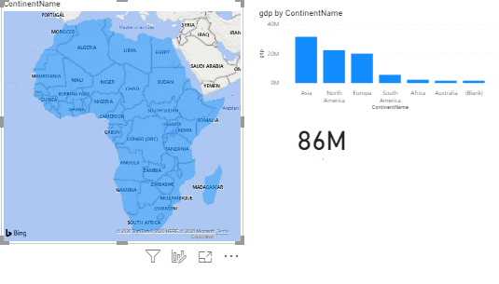
Filter
Keep the Basic Alternative
Select Africa and observe the change in the geographic map visualization

Slide 10
Filter
Compare with the visual next to it, notice that the filter is applied only for the case of the visual to the one on the left

Slide 11
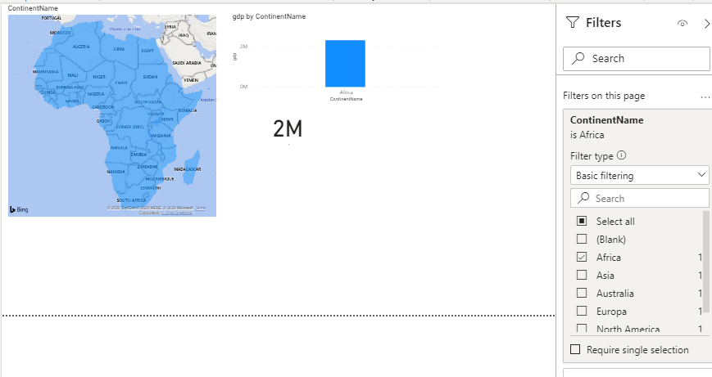
Filter
Apply the filter at the page level instead of the map visual and notice the change in behavior of all three visuals

Slide 12
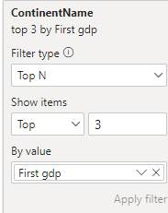
Filter
Navigate to the details page and notice that the filter is not applied at this different page level
Go back to the Gdp page and apply the filter based on ContinentName on all pages and notice that the filter is now applied on all pages in the report without exception
Go back to the Visual level configuration and now test the filter type Top N
Configure the filter as shown in the figure
1
2
3
4

Slide 13
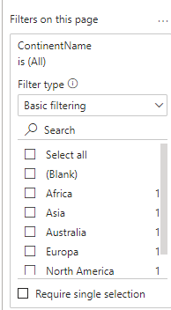
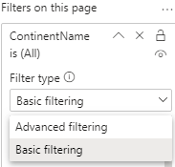
Filter
Go back to the page level filter to notice that Top N is no longer a filter type option
Note that the filter types are missing the Top N even for the all pages level and it is only applicable at the Visual level only

Slide 14
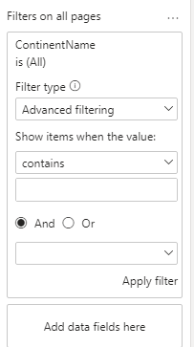
Filter
Note when changing to the Advanced type we will have more granularity in terms of data filtration
1
2
3
4

Slide 15
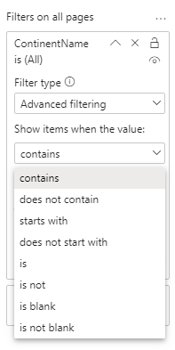
Filter
Note that the application of the advanced filter is assisted with a defined number of filtration criteria.

Slide 16
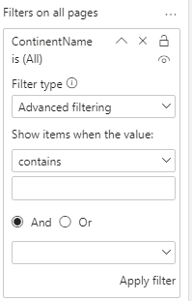
Filter
Note that it is applicable to at most two selections per filter in advanced mode

Slide 17
Thank you
Thank you

